Slide 1
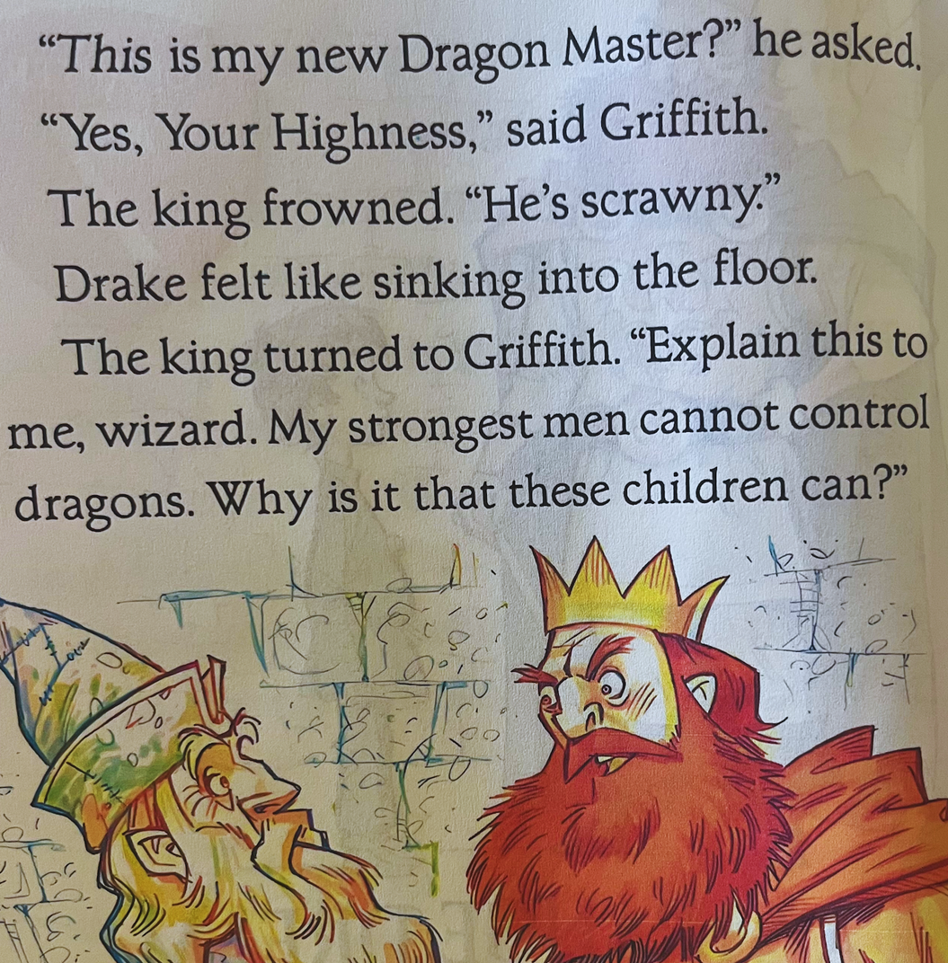
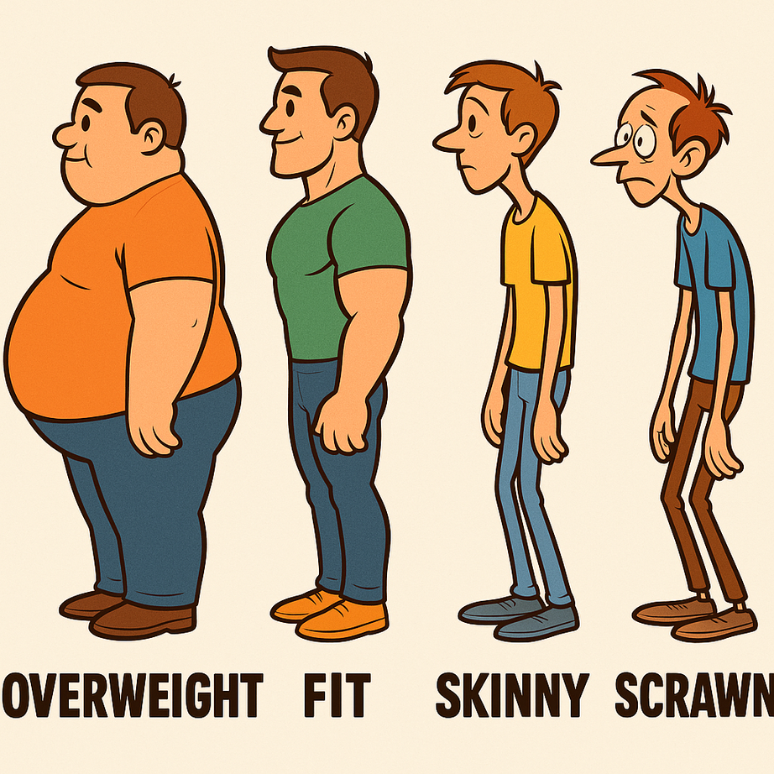
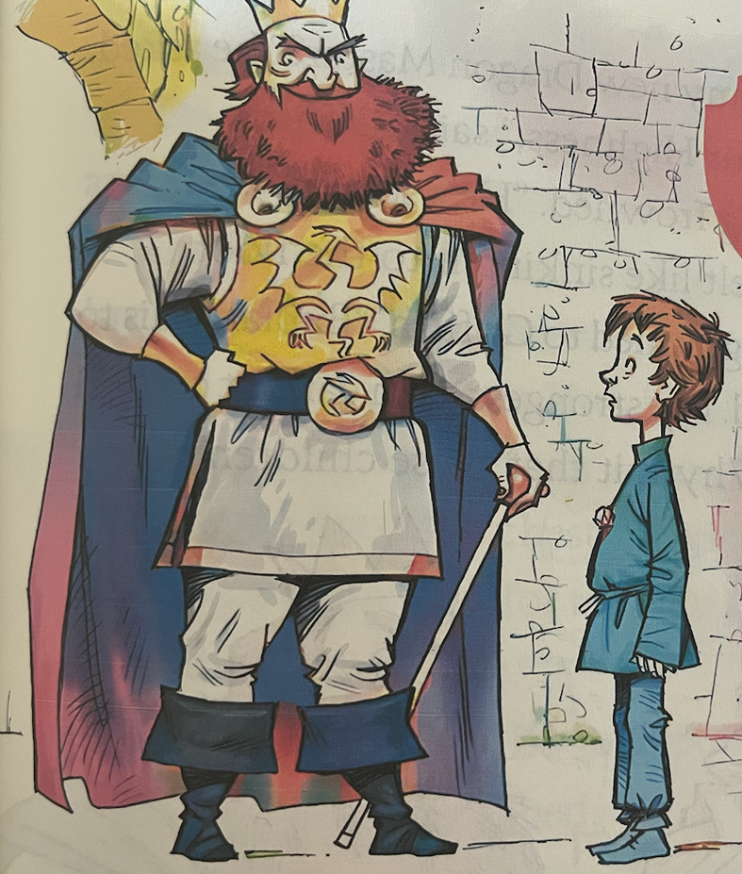
Overweight
Fit
Skinny
Scrowny

Slide 2
Meaning:
Meaning:
Overweight means a person or animal has more body weight than what’s healthy, like carrying extra heavy bags all the time.
Fit means your body is strong, healthy, and full of energy so you can run, jump, and play easily.
Sentence Example:
Sentence Example:
My dad goes jogging every day, so he is very fit and can play soccer with me for a long time.
Tom’s cat is overweight, so it has a big round belly and moves slowly.”
Overweight
Fit

Slide 3
Meaning:
Meaning:
Skinny means very thin, with little fat or muscle.
Scrawny means very, very thin and weak-looking, like having tiny arms and legs.
Sentence Example:
Sentence Example:
The skinny dog could slip through the small gap in the fence.
The scrawny tree in the garden had only a few small branches and looked weak.
Skinny
Scrowny

Slide 4
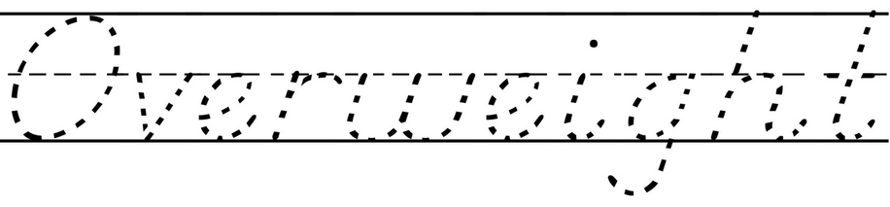
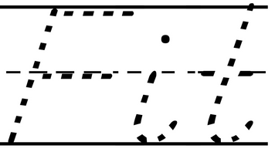
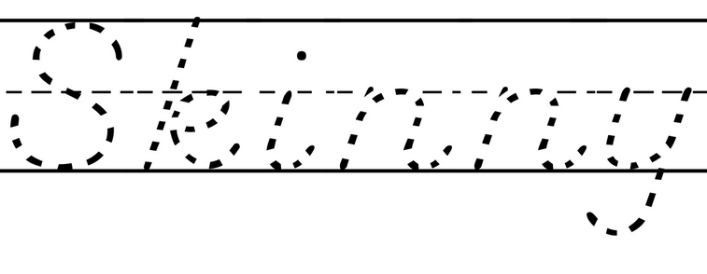
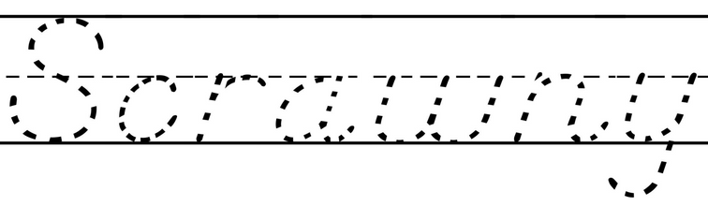
Tracing
Add missing characters
  Over_eigh_
  F_t
  S_inny
  Scra_ny
  O_erw_ight
  Fi_
  Ski__y
  Scr__ny

Slide 5
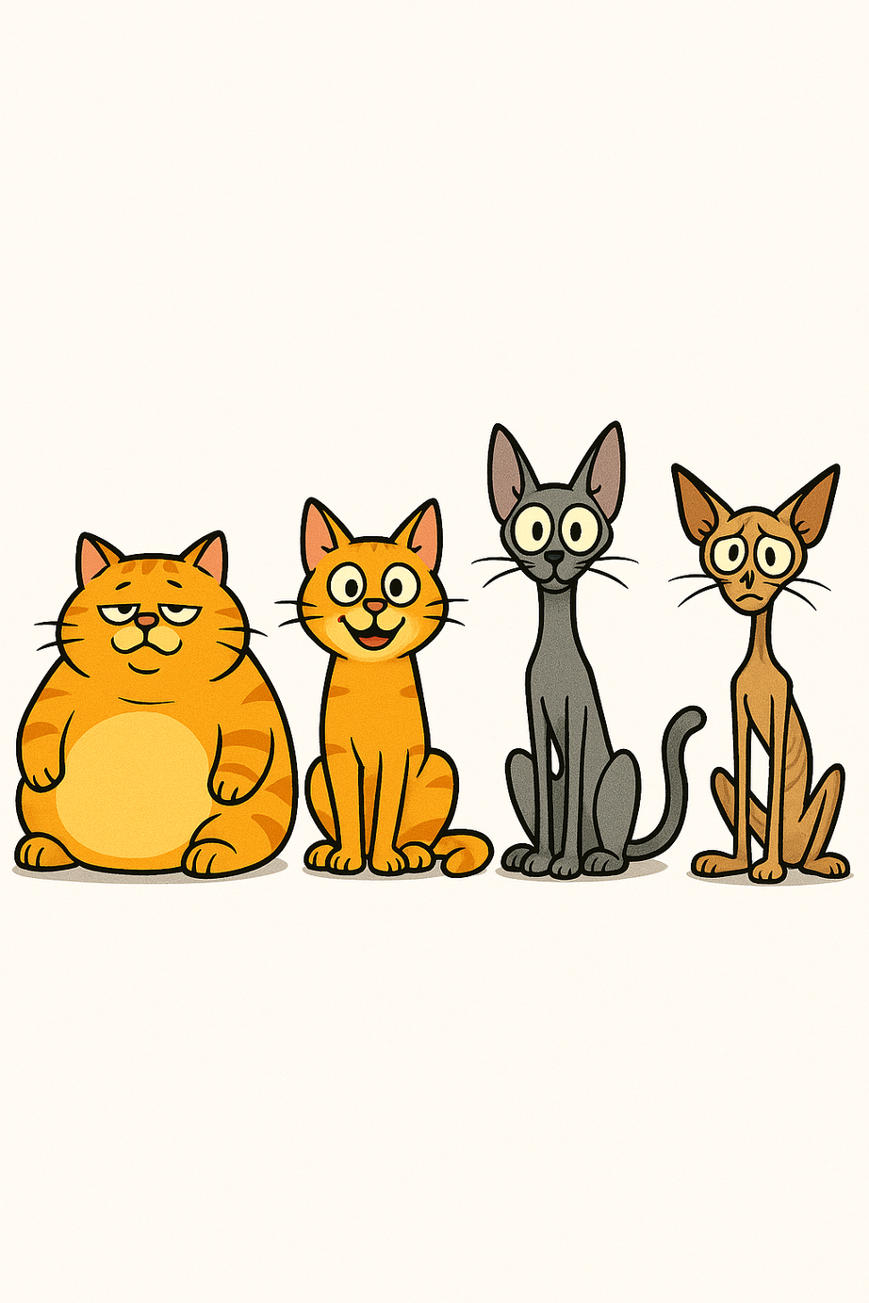
Matching
Word scrambling
👉 Task: Unscramble the letters to find the correct word.
1: Y N R C S A W
_ _ _ _ _ _ _
2: R V E I H G T O W E
_ _ _ _ _ _ _ _ _ _
.
.
.
.
3: N S Y K I N
.
.
.
.
_ _ _ _ _ _
Scrowny
Skinny
Overweight
Fit
4: T I F
_ _ _

